Slide 1

Example:
“I will get wet if it rains and I go out of the house”
Let Propositions be:
W : “I will get wet “
R : “it rains “
S : “I go out of the house”
(S ˄ R) → W

Slide 2
Using Propositional Logic
Representing simple facts
It is raining RAINING
It is sunny
SUNNY
It is windy WINDY
If it is raining, then it is not sunny
RAINING → ¬SUNNY

Slide 3
Using Predicate Logic
1. Marcus was a man.
man(Marcus)
2. Marcus was a Pompeian.
Pompeian(Marcus)

Slide 4
Nested Quantifiers
We can use both ∀ and ∃ seperately
Ex: “ everybody loves somebody ”
∀x: ∃y: loves ( x , y)
Connection between ∀ and ∃
“ everyone dislikes garlic”
∀ x: ¬ like ( x , garlic )
This can be also said as:
“there does not exists someone who likes garlic”
¬ ∃x: like (x, garlic)

Slide 5
All Romans were either loyal to Caesar or hated him.
∀x: Roman(x) → loyalto (x, Caesar) ∨ hate(x, Caesar)
Every one is loyal to someone.
∀x: ∃y: loyalto(x, y) ∃y: ∀x: loyalto(x, y)
People only try to assassinate rulers they are not loyal to.
∀x: ∀y: person(x) ∧ ruler(y) ∧ tryassassinate(x, y)
→ ¬loyalto(x, y)

Slide 6
6. “All Pompeians were Romans”
∀x: Pompeian(x) → Roman(x)
8. Marcus tried to assassinate Caesar.
tryassassinate(Marcus, Caesar)

Slide 7
Some more examples
“all indoor games are easy”
∀x: indoor_game( x) → easy(x)
“Rameez likes only cricket”
Like(Rameez, Cricket)
“Any person who is respected by every person is a king”
∃x:∀y: { person(x) ∧ person(y) ∧ respects (y ,x)→ king( x)}

Slide 8
Translate to 1st Order Logic
•
Snakes are reptiles.
(S(x): x is a snake, R(x): x is a reptile)
None but the brave deserve the fair. (B(x): x is brave, D(x): x deserves the fair)
(B(x): x is brave, F(x): x is fair, D(x,y): x deserves y)
No coat is waterproof, unless it has been specially treated.
(C(x): x is a coat, W(x): x is waterproof, S(x): x has
been specially treated)
No car that is over 10 years old will be repaired if it is severely damaged.
(C(x): x is a car, O(x): x is over 10 years old, R(x): x will be repaired, D(x): x is severely damaged)
•
•
•

Slide 9
Solutions
•
Snakes are reptiles.
∀x (S(x) → R(x)) Not: ∀x (S(x) ∧ R(x))
None but the brave deserve the fair.
∀x (D(x) → B(x))
∀x (∀y (F(y) ∧ D(x,y)) → B(x))
No coat is waterproof, unless it has been specially treated.
∀x (C(x) → ¬W(x) ∨ S(x))
No car that is over 10 years old will be repaired if it is severely damaged.
∀x (C(x) ∧ O(x) → (D(x) → ¬R(x))
•
•
•

Slide 10
Example:
Representing Facts in First-Order Logic
Lucy* is a professor
All professors are people.
John is the dean.
Deans are professors.
All professors consider the dean a friend or don’t know him.
Everyone is a friend of someone.
People only criticize people that are not their friends.
Lucy criticized John .
* Name changed for privacy reasons.

Slide 11
Same example, more formally
Knowledge base:
is-prof(lucy)
∀ x ( is-prof(x) → is-person(x) )
is-dean(John)
∀ x (is-dean(x) → is-prof(x))
∀ x (∀ y ( is-prof(x) ∧ is-dean(y) → is-friend-of(y,x) ∨ ¬knows(x, y) ) )
∀ x (∃ y ( is-friend-of (y, x) ) )
∀ x (∀ y (is-person(x) ∧ is-person(y) ∧ criticize (x,y) → ¬is-friend-of (y,x)))
criticize(lucy, John )
Question: Is John no friend of Lucy?
¬is-friend-of(John ,lucy)

Slide 12
Semantics
Car is a Vehicle
Toyota is a Car
It has red Color
It has four wheels
Truck is also a Vehicle
Truck is heavy duty
It has 2 small wheels 2 Large
It can transport Bicycles
Bicyles are also vehicle
It has 2 wheel

Slide 13
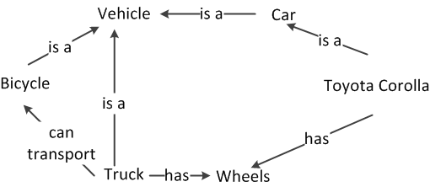
Car is a Vehicle
Toyota is a Car
It has red Color
It has four wheels
Truck is also a Vehicle
Truck is heavy duty
It has 2 small wheels 2 Large
It can transport Bicycles
Bicyles are also vehicle
It has 2 wheel

Slide 14
Susan is a Wife of Tom
Tom is a husband of Susan
Tom is father of John.
Susan is mother of john
Ann is siste of Carol
Ann is Wife of Bill
Both are parents of Susan
Carol is wife of David
Both are parents of Tom

Slide 15
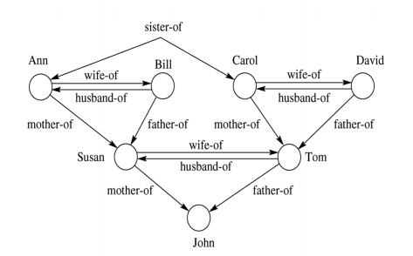
Susan is a Wife of Tom
Tom is a husband of Susan
Tom is father of John.
Susan is mother of john
Ann is siste of Carol
Ann is Wife of Bill
Both are parents of Susan
Carol is wife of David
Both are parents of Tom

